Slide 1

ANTIQUE ITEM GALLERY
PRESENTED BY:
1.SAURABH GOSAVI
2.SHUBHAM SHETE
3.PARESH BHOI
4.SUMIT DHANEGAONKAR
GUIDED BY :
Mrs. HARSHITA MAHESHWARI

Slide 2
CONTENT
1.INTRODUCTION
2.OBJECTIVE
3.ADVANTAGE
4.FLOWCHART
5.FUTURE SCOPE
6.TECHNOLOGY
7.CONCLUSION

Slide 3
INTRODUCTION
The business-to-consumer aspect of product is the most visible business use of the World Wide Web. The primary goal of a site is to sell items online.
This project deals with developing a website for Online Antique Items Sale.
It provides the user with a catalog of different antique items available for purchase in the store.
In order to facilitate online purchase an web application is provided to the user.

Slide 4
OBJECTIVE
Reduce management costs.
Providing a unique customer experience.
Increasing the number of loyal customers.
Boosting the efficiency of services.
Developing relevant target.
Making responsive ecommerce website.

Slide 5
ADVANTAGES
Faster buying process. Customers can spend less time shopping for what they want.
Store and product listing creation.
Cost reduction.
Affordable advertising and marketing.
Flexibility for customers.
Faster response to buyer/market demands.

Slide 6
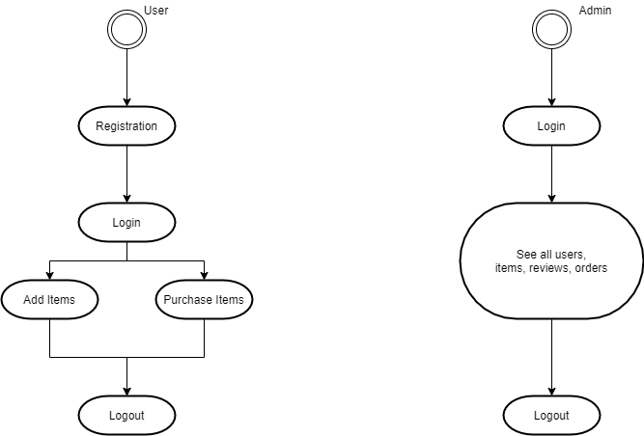
FLOWCHART

Slide 7
FUTURE SCOPE
We are thinking of some modifications and adding some advanced new features in out system. Some of them are:-
Bidding option.
Users can signup / login using their social media account such as Facebook.
Add more feature in admin panel.
E-mail Services.

Slide 8
TECHNOLOGY
Languages | Tools
Spring Boot | Eclipse IDE
MYSQL | Hibernate ORM
JavaScript | Visual Studio Code
Bootstrap
CSS3
JSP
jQuery

Slide 9
CONCLUSION
E-Commerce is not just about conducting business transactions via the Internet. Its impact will be far-reaching, and more prominent then we know currently. This is because the revolution in information technology is happening simultaneously with other developments, especially the globalization of the business.
As companies are gaining high profits, more and more other companies are developing their websites to increase their profits. Since more businesses are being held online resulting in high economy development and emergence of a more.

Slide 10
Thank
You

